Slide 1
HADOOP ECOSYSTEM

Slide 2
Introduction:
Hadoop Ecosystem is a platform or a suite which provides various services to solve the big data problems. It includes Apache projects and various commercial tools and solutions.

Slide 3
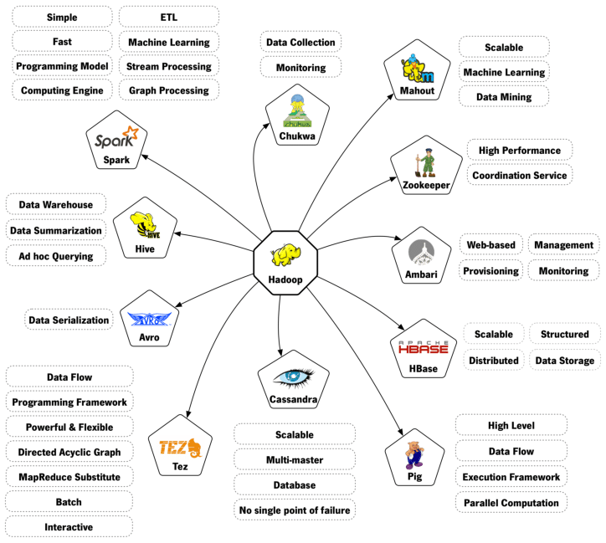

Slide 4
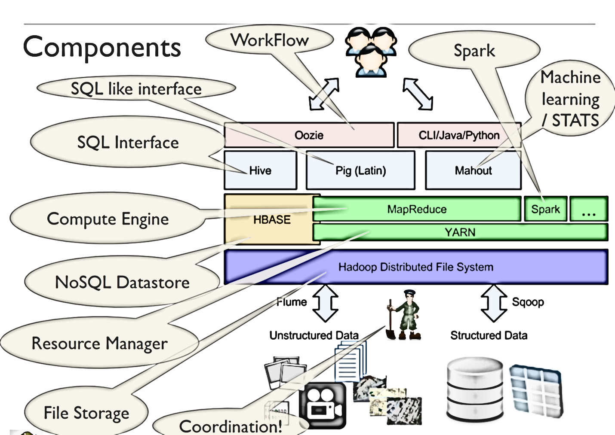

Slide 5
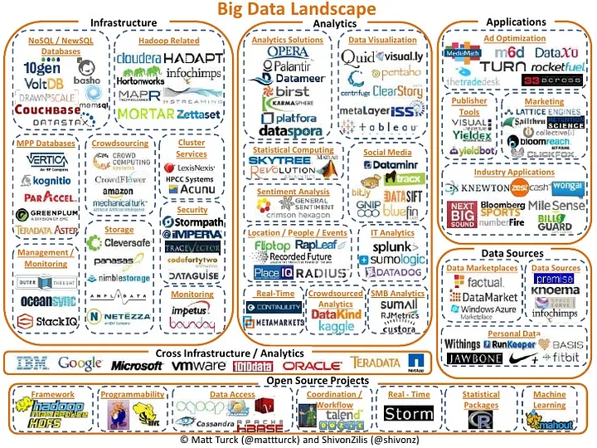

Slide 6
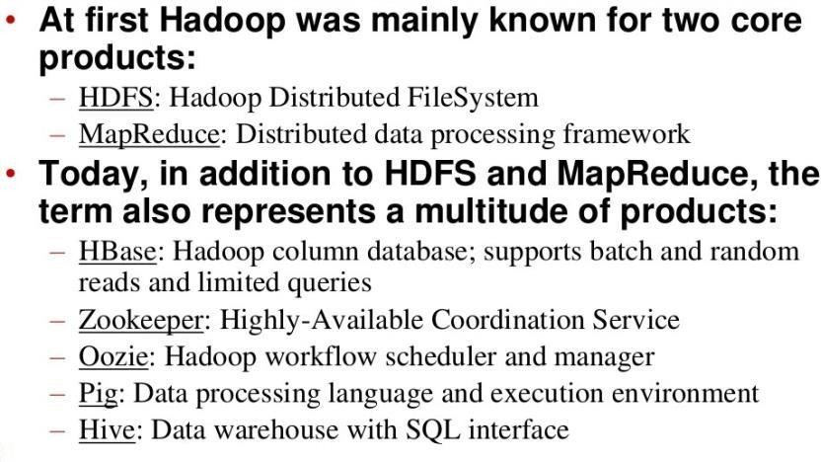

Slide 7
Big data Handling
Any Big data handling process can roughly be divided into four layers, each with its tools. These layers are:
Data Ingestion
Data Storage
Resource Management
Data Processing and analysis
Data Access

Slide 8
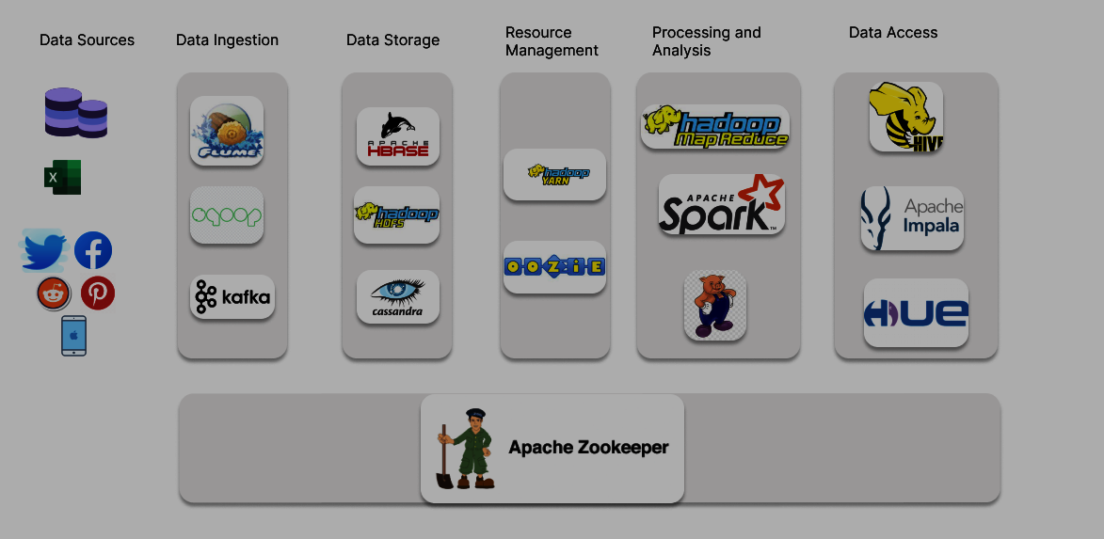

Slide 9
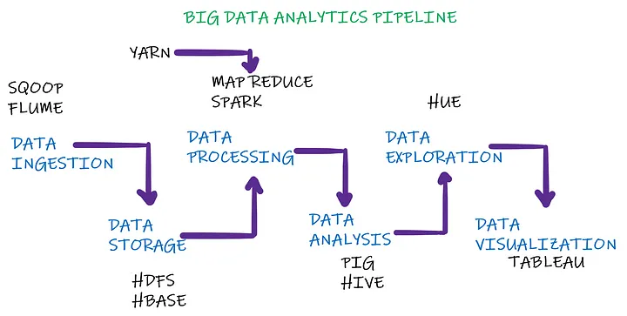

Slide 10
Components
Hadoop Ecosystem can be divided into various categories as mentioned below :
Core Hadoop
Data Access
Data Storage
Interaction-Visualization-Execution-Development
Data Intelligence
Data Serialization
Data Integration
Management, Monitoring and Orchestration

Slide 11
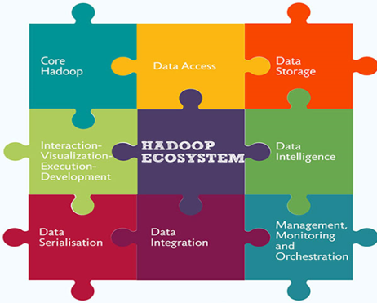

Slide 12
Core Hadoop
The base Apache Hadoop framework is composed of the following modules:
Hadoop Common :– The Hadoop Common package contains the necessary Java Archive (JAR) files and scripts needed to start Hadoop.
Hadoop Distributed File System (HDFS) :– a distributed
file-system that stores data on commodity machines,
providing very high aggregate bandwidth across the cluster
Hadoop YARN:– a resource-management platform responsible for managing computing resources in clusters and using them for scheduling of users' applications
Hadoop MapReduce:– an implementation of the MapReduce programming model for large scale data processing.

Slide 13
2. Data Access Components of Hadoop Ecosystem
Under this category,
Hive
Pig
Tez
Hcatalog

Slide 14
HIVE
SQL-like queries and tables on large datasets
Features of HIVE:-
1. An sql like interface to Hadoop.
2. Data warehouse infrastructure built on top of Hadoop
3. Provide data summarization, query and analysis
4. Query execution via MapReduce
5. Hive interpreter convert the query to Map reduce format.
6. Open source project.
7. Developed by Facebook
8. Also used by Netflix, Cnet, Digg, eHarmony etc.

Slide 15
PIG
Data flow language and compiler
Features of pig:-
Approximately 10 lines of Pig code is equal to 200 lines of MapReduce code.
Apache Pig is a platform, used to analyze large data sets representing them as data flows.
Apache Pig allows to write complex MapReduce programs using a simple scripting language.
Pig translate Pig Latin script into MapReduce to execute within Hadoop.
It is designed to provide an abstraction over MapReduce, reducing the complexities of writing a MapReduce program.
In Pig, there is a language we use to analyze data in Hadoop. That is what we call Pig Latin.
Also, it is a high-level data processing language that offers a rich set of data types and operators to perform several operations on the data.
The compiler internally converts pig latin to MapReduce. It produces a sequential set of MapReduce jobs, and that’s an abstraction (which works like black box).
PIG was initially developed by Yahoo.
It gives you a platform for building data flow for ETL (Extract, Transform and Load), processing and analyzing huge data sets.
Developed by Yahoo

Slide 16
HCatalog
A new integrated metadata layer called HCatalog was added to the Hadoop ecosystem in late 2011.
It is built on top of the Hive metastore currently and incorporates components from Hive DDL.
HCatalog provides read and write interfaces for Pig and MapReduce, and Hive in one integrated repository.
By an integrated repository the users can explore any data across Hadoop using the tools built on its platform.

Slide 17
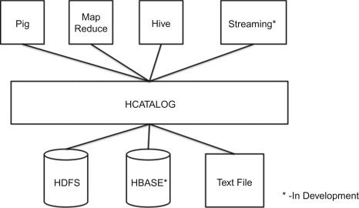

Slide 18
3. Data Storage Component of Hadoop Ecosystem
HBase
Cassandra

Slide 19
HBASE
Hadoop database for random read/write access
Features of HBASE:-
Hadoop Database or HBASE is a non-relational (NoSQL) database that runs on top of HDFS.
It was created for large table which have billions of rows and millions of columns with fault tolerance capability and horizontal scalability and based on Google Big Table.Automatic sharding
Hadoop can perform only batch processing, and data will be accessed only in a sequential manner for random access of huge data HBASE is used.Hadoop/HDFS Integration
Facebook is one the largest users of HBase with its messaging platform built on top of HBase in 2010.

Slide 20
NoSQL
NoSQL is a class of database management system identified by its non-adherence to the widely used relational database management system (RDBMS) model with its structured query language(SQL).
NOSQL has evolved to mean Not Only SQL
NOSQL has become prominent with the advent of web scale data and systems created by Google, Facebook, Amazon, Twitter and others to manage data for which SQL was not the best fit.

Slide 21
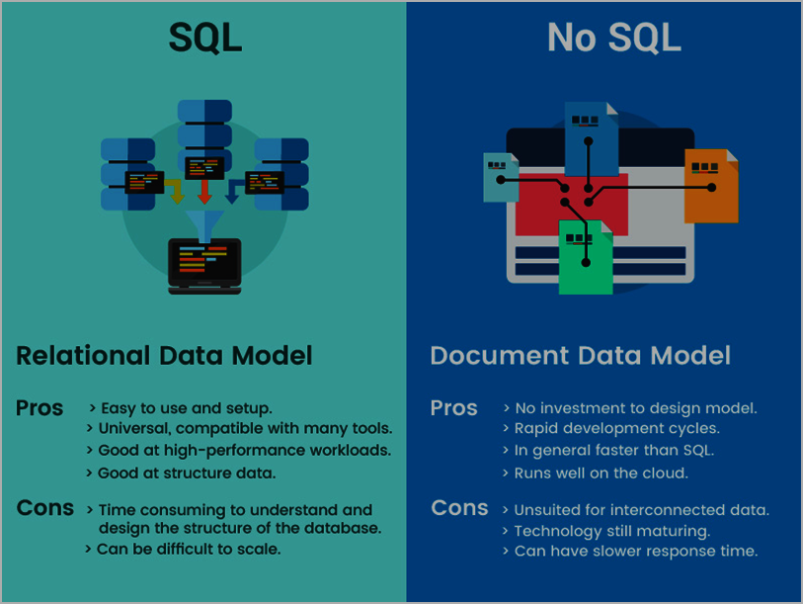
Pictorial View of sql and nosql db

Slide 22
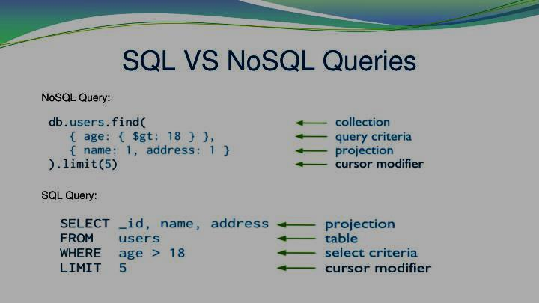
Difference in their query syntax

Slide 23
Cassandra
database which is designed for high speed, online transactional data.
The specialty of Cassandra lies in the fact, that it works without a single point of failure.
It is a type of NoSQL databas.

Slide 24
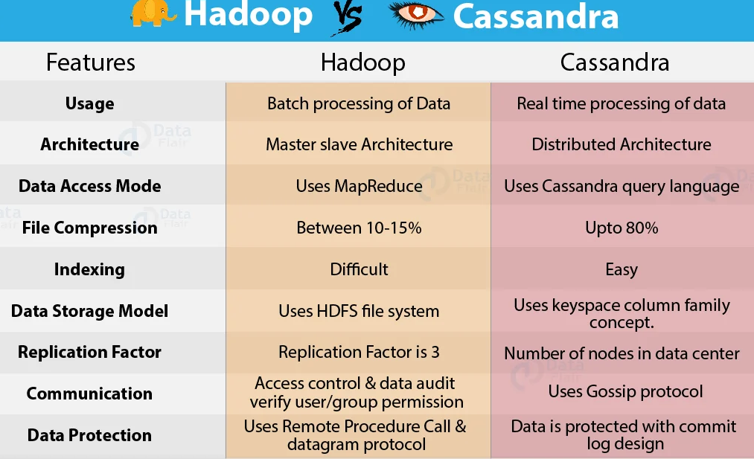

Slide 25
4. Data Interaction-Visualization-Execution-Development

Slide 26
APACHE SPARK
Apache Spark is a framework for real time data analytics in a distributed computing environment.
The Spark is written in Scala and was originally developed at the University of California, Berkeley.
It executes in-memory computations to increase speed of data processing over Map-Reduce.
It is 100x faster than Hadoop for large scale data processing by exploiting in-memory computations and other optimizations. Therefore, it requires high processing power than Map-Reduce.

Slide 27
Data Intelligence Components of Hadoop Ecosystem

Slide 28
Mahout
Apache Mahout is a platform to run scalable Machine Learning algorithms leveraging Hadoop distributed computing.
Mahout is an open source machine learning library written in java.
Mahout aims to be the machine learning tool of choice when the collection of data to be processed is very large, perhaps far too large for a single machine.
Scalable machine learning implementations in Mahout are written in Java, and some portions are built upon Apache’s Hadoop distributed computation project.

Slide 29
6. Data Serialization Components of Hadoop Ecosystem
Thrift
Avro

Slide 30
Apache Thrift
The Apache Thrift software framework, for scalable cross-language services development, combines a software stack with a code generation engine to build services that work efficiently and seamlessly between C++, Java, Python, PHP, Ruby, Erlang, Perl, Haskell, C#, Cocoa, JavaScript, Node.js, Smalltalk, OCaml and Delphi and other languages.

Slide 31
Avro
Avro is a remote procedure call and data serialization framework developed within Apache’s Hadoop project.
It is a serialization system for efficient, cross-language RPC and persistent data storage.
It is a framework for performing remote procedure calls and data serialization.
It uses JSON for defining data types and protocols, and serializes data in a compact binary format.
Its primary use is in Apache Hadoop, where it can provide both a serialization format for persistent data, and a wire format for communication between Hadoop nodes, and from client programs to the Hadoop services.

Slide 32
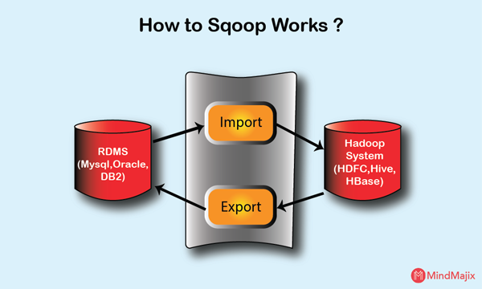
7. Data Integration Components of Hadoop Ecosystem

Slide 33
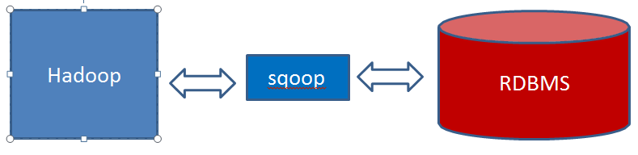
Sqoop : SQL + HADOOP = SQOOP
Integration of databases and data warehouses with Hadoop
Features of Sqoop:-
Command-line interface for transforming data between relational database and Hadoop
Support incremental imports
Imports use to populate tables in Hadoop
Exports use to put data from Hadoop into relational database such as SQL server

Slide 34
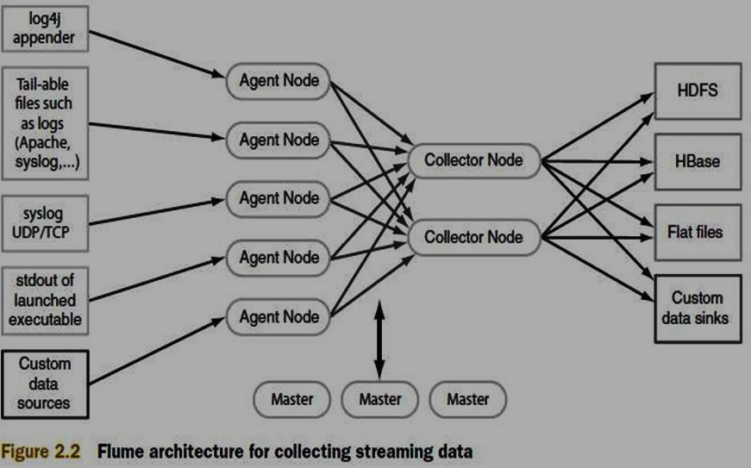
FLUME
Configurable streaming data collection
Apache Flume is a distributed, reliable, and available service for efficiently collecting, aggregating, and moving large amounts of streaming data into the Hadoop Distributed File System (HDFS).

Slide 35
APACHE FLUME
Ingesting data is an important part of our Hadoop Ecosystem.
The Flume is a service which helps in ingesting unstructured and semi-structured data into HDFS.
It gives us a solution which is reliable and distributed and helps us in collecting, aggregating and moving large amount of data sets.
It helps us to ingest online streaming data from various sources like network traffic, social media, email messages, log files etc. in HDFS.

Slide 36
8. Monitoring, Management and Orchestration components of Hadoop Ecosystem

Slide 37
OOZIE
To design and schedule workflows
Oozie is a workflow scheduler where the workflows are expressed as Directed Acyclic Graphs. Oozie runs in a Java servlet container Tomcat and makes use of a database to store all the running workflow instances, their states ad variables along with the workflow definitions to manage Hadoop jobs (MapReduce, Sqoop, Pig and Hive).The workflows in Oozie are executed based on data and time dependencies.

Slide 38
ZOOKEEPER
Coordination service for distributed applications
Features of Zookeeper:-
Because coordinating distributed systems is a Zoo.
ZooKeeper is a centralized service for maintaining configuration information, naming, providing distributed synchronization, and providing group services.

Slide 39
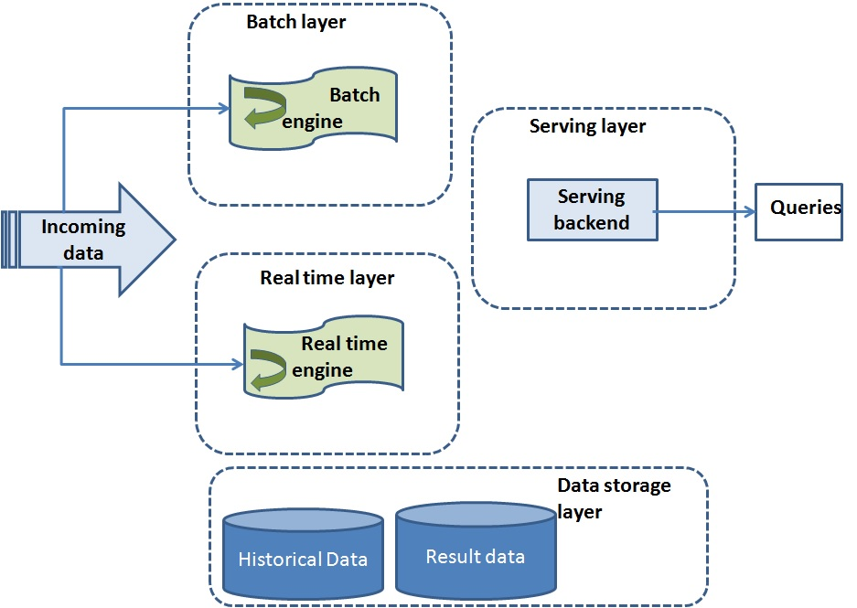

Slide 40
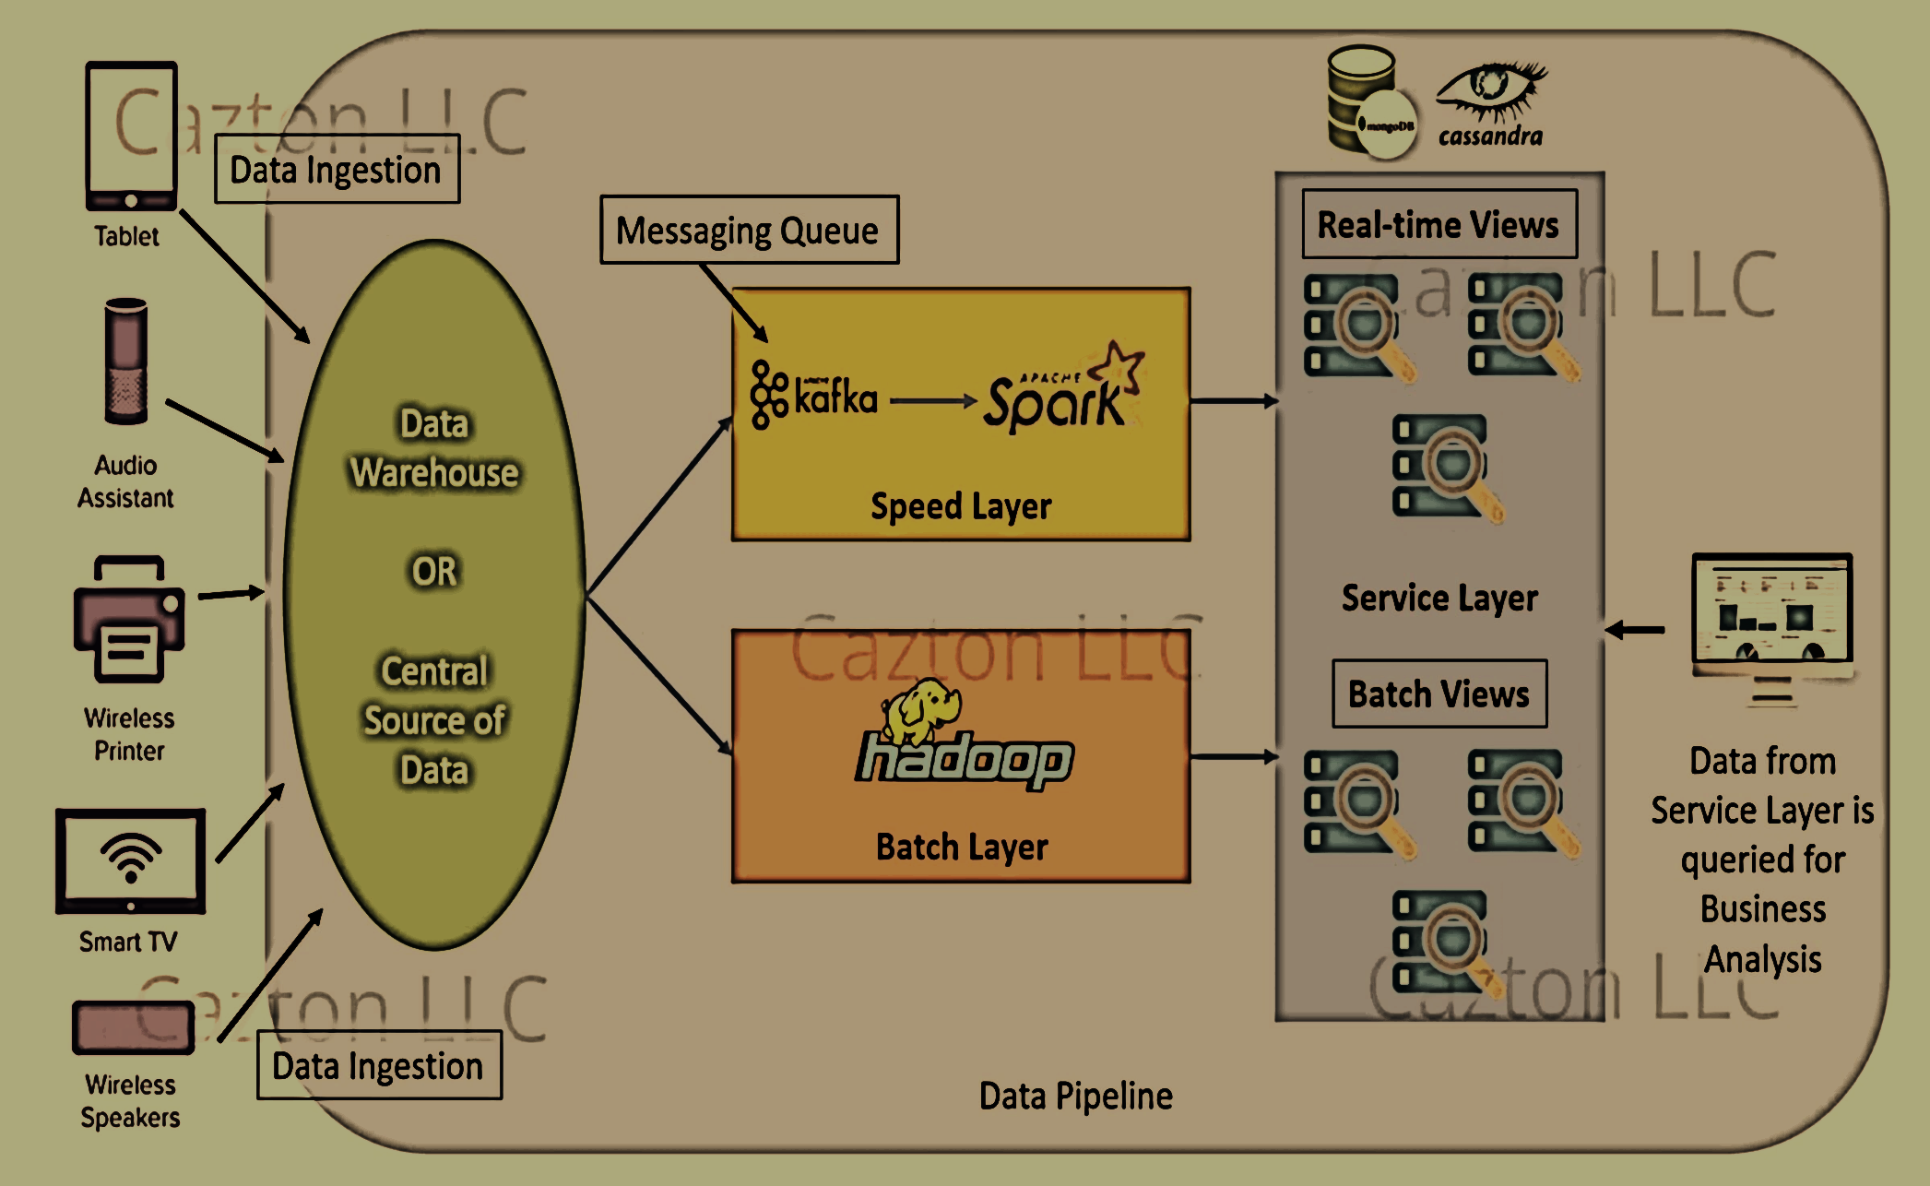

Slide 41
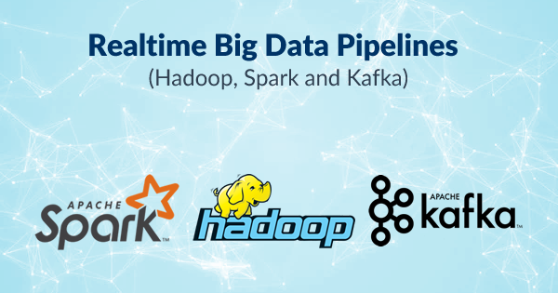

Slide 42
Real-time Big Data Pipeline
Helps to make operational decisions.
The decisions built out of the results will be applied to business processes, different production activities, and transactions in real-time.
It can be applied to prescriptive or pre-existing models.
Helps to generate historical and current data concurrently.
Generates alerts based on predefined parameters.
Monitors constantly for changing transactional data sets in real-time

